Slide 1


A Taste of
COMPUTER
SCIENCE

Slide 2

Brian Lackaye
Associate Dean –
Graduate Student Administration b.lackaye@northeastern.edu
PK Agarwal
Regional Dean and CEO of
Silicon Valley Campus p.agarwal@northeastern.edu
KEY CONTACT

Slide 3
GOAL
FOR
THE
DAY
Understand
what Computer Science is
Have fun
      See CS in action
      in your own work and everyday life
      Determine what path forward
      you want to take to
      further your education in CS

Slide 4

WHAT IS CS?
The theory of computing
The art of building (software) aamachines

Slide 5

CS is about
SOLVING PROBLEMS
INPUT
PROCESS
OUTPUT

Slide 6
People are SOPHISTICATED
We understand very complicated information.

Slide 7



WE UNDERSTAND all sorts of things
5
A
.

Slide 8

1
Computers
Understand
Numbers
5
3
8
4

Slide 9
Back to Basics
19
100’s
10’s
1’s
9 x 1 = 9
1 x 10 = 10

Slide 10
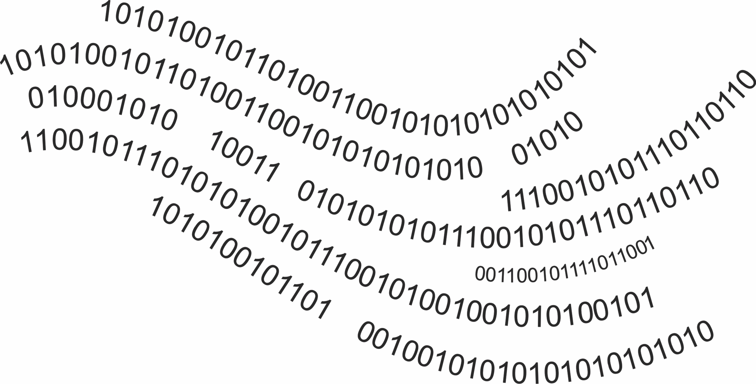
Computers Are Fundamentally Simple
They only understand binary

Slide 11
So, What About
Letters, @, #,
And All That Jazz?
A B
@ #

Slide 12

Other Things
Colors are a mix of
Red, Green, and Blue.
A color is a combination of
three numbers representing the
intensity of R, G, B.
0 – 255 0 – 255 0 – 255

Slide 13
WE CAN CREATE complicated objects from bits

Slide 14


VIDEO
It’s a stream of
PICTURES
and
AUDIO

Slide 15

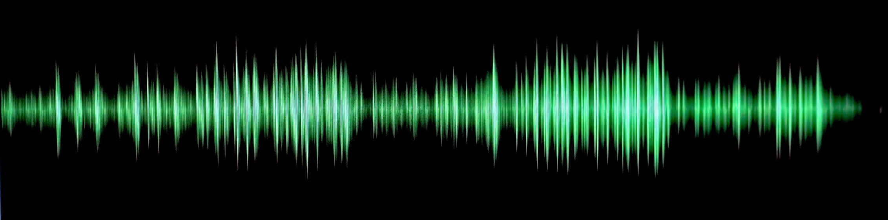

VIDEO
Pictures
Audio
Are a collection of pixels
Stream of digitized samples
Digitized
Samples
pixels

Slide 16


Pictures
Audio
Are a collection of pixels
Stream of digitized samples
    Stream of digitized samples
    (44K/s)
    CD quality audio is 16 bits per channel (x2 for stereo)
111111110000000000000000
Pixel
24 bits
000000000000000011111111
Computer memory
10101010101010101010101010101010

Slide 17
Complex Objects Reduce to Simple Bits
VIDEO
DOCUMENTS
IMAGE
WORDS
PIXEL
LETTERS
BIT
BIT
BIT
BIT
BIT
BIT
BIT
BIT
BIT
BIT

Slide 18
STRETCH

Slide 19
If Input and Output Are Data, What’s in the Middle?
INPUT
DATA
PROCESS
OUTPUT
DATA
ALGORITHM

Slide 20
Algorithms
A set of instructions to
do / make / accomplish something
Take input and produce output

Slide 21
CS is about figuring out
  CORRECT algorithms and the data they need

Slide 22
Getting a Program to Run
Instructions in Binary
What Intel or AMD provides

Slide 23
CODE SEGMENT
ASSUME DS:DATA,CS:CODE
START :
MOV AX,DATA
MOV DS,AX
MOV BL,00H
MOV CH,00H
MOV CL,0AH
Instructions in Assembly
Instructions in Binary
What Intel or AMD engineers might develop code in

Slide 24
public class HelloWorld
{
public static void main(String[] args) {
System.out.println("Hello World!");
}
}
High Level Programming Language
Instructions in Assembly
Instructions in Binary
What most CS Uses

Slide 25
The
Stack has
NO limit

Slide 26
O(n log₂ n)
O(n)
Time →
O(log₂ n)
Number of Things →

Slide 27


Challenge
Task: Sort yourselves alphabetically
Keep track of the number of times they ask for a name and decide who comes first

Slide 28
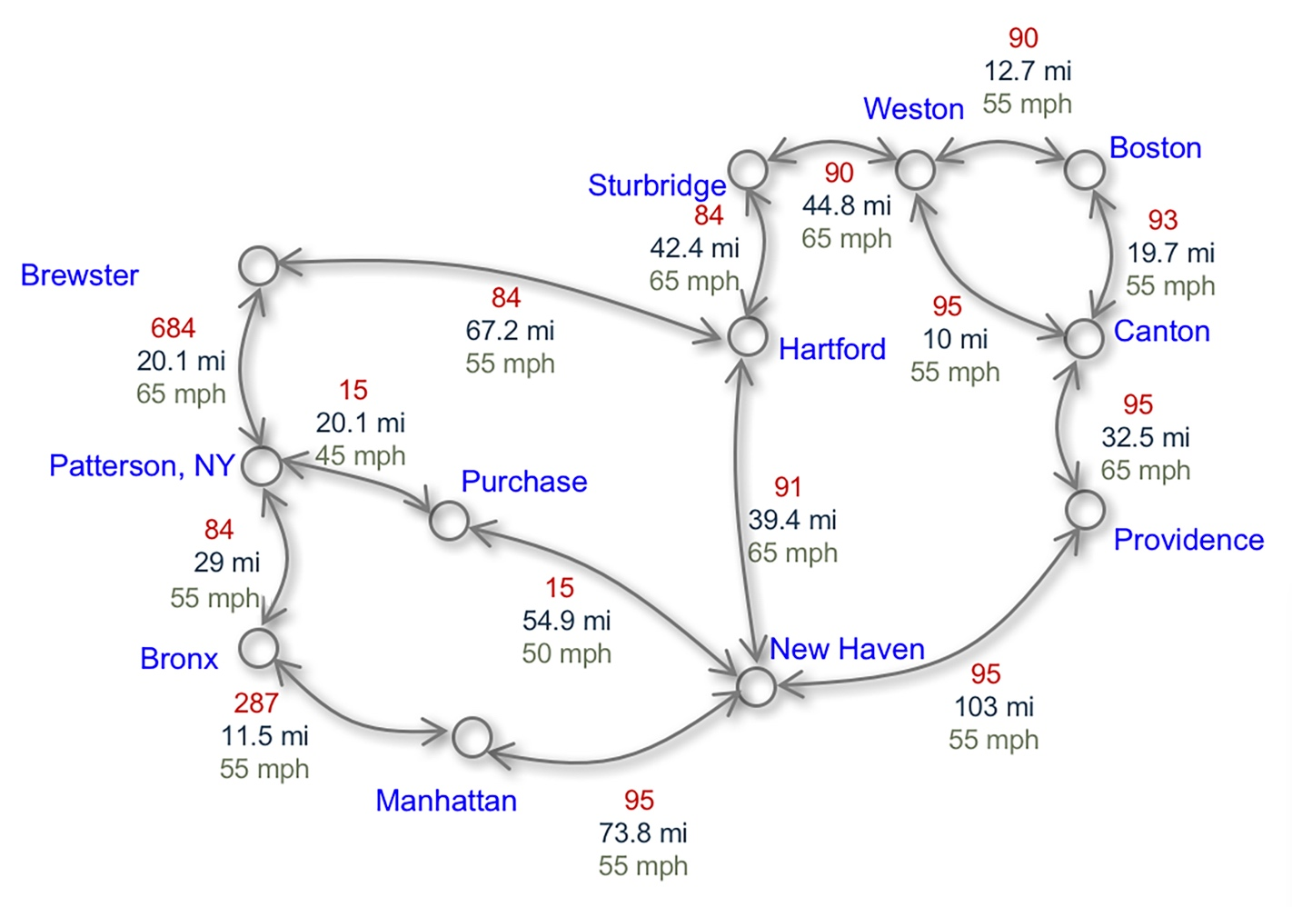
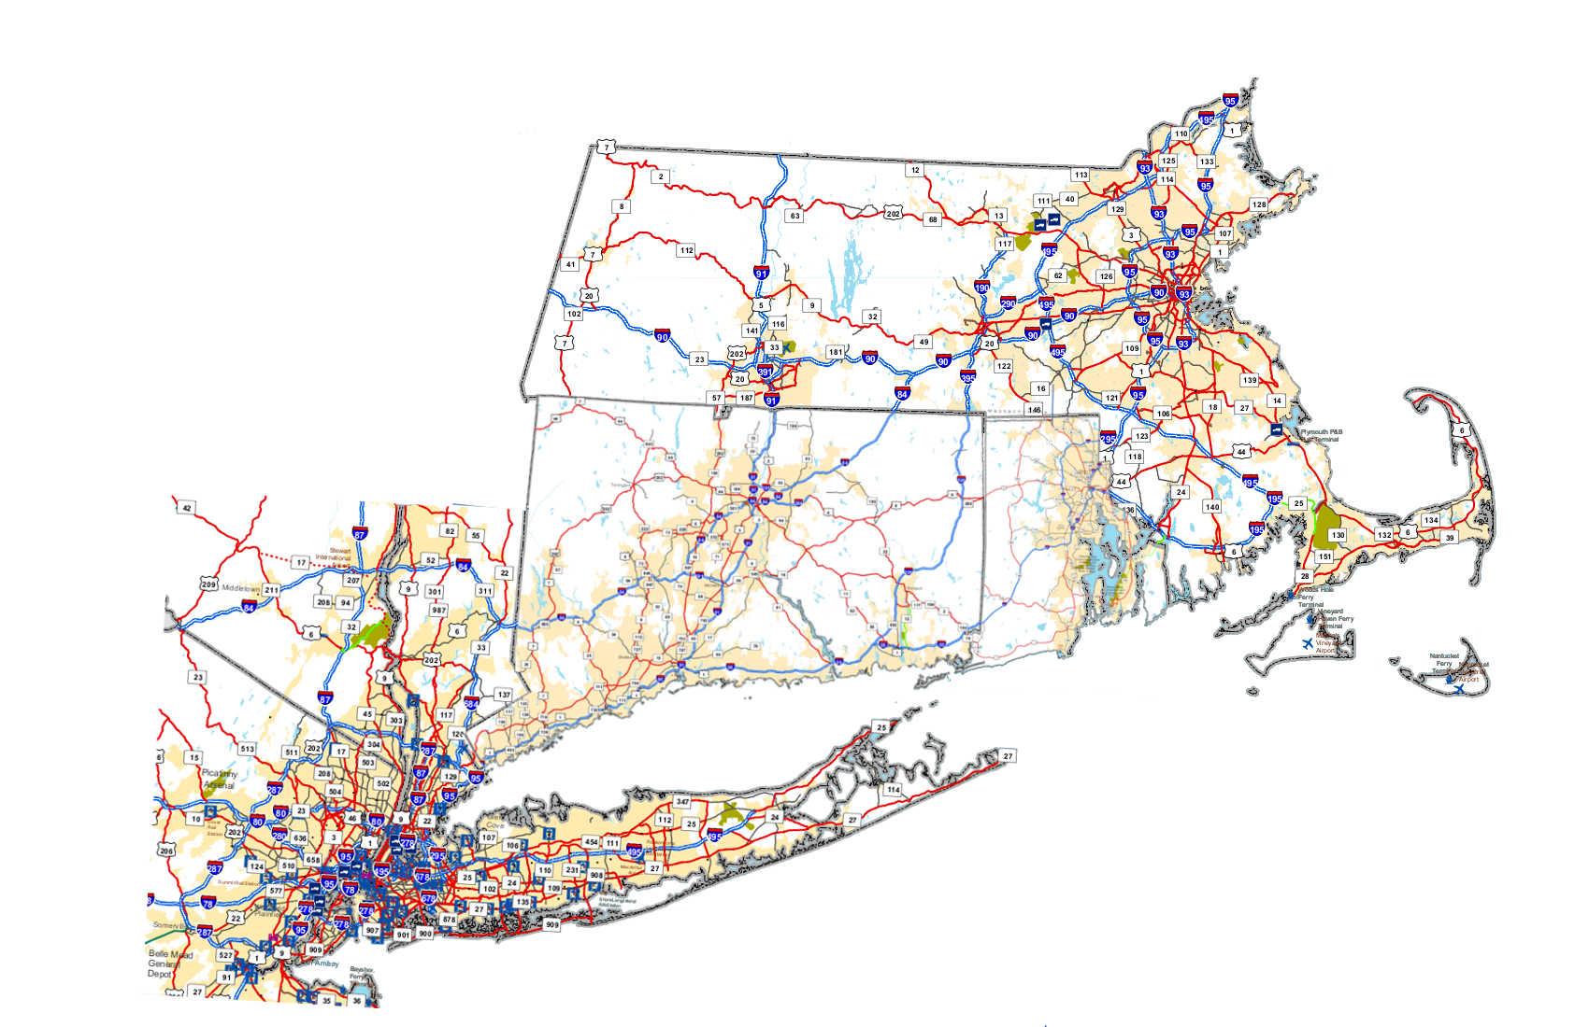
START
Boston
END
NYC
This is what you
use to plan a trip
This is how
CS sees it

Slide 29
This is how the computer stores it
 | Boston | Weston | Canton | Providence | New Haven | Sturbridge | Hartford | Brewster | Patterson | Purchase | Bronx | Manhattan
Boston |  | 12.7 | 19.7
Weston | 12.7 |  | 10 |  |  | 44.8
Canton | 19.7 | 10
Providence |  |  |  |  | 103
New Haven |  |  |  | 103 |  |  | 39.4 |  |  | 54.9
Sturbridge |  | 44.8 |  |  |  |  | 42.4
Hartford |  |  |  |  | 39.4 | 42.4 |  | 67.2
Brewster |  |  |  |  |  |  | 67.2 |  | 20.1
Patterson |  |  |  |  |  |  |  | 20.1 |  |  | 20.1
Purchase |  |  |  |  |  |  |  |  |  |  | 15
Bronx |  |  |  |  |  |  |  |  | 20.1 | 15 |  | 11.5
Manhattan |  |  |  | 73.8 |  |  |  |  |  |  | 11.5

Slide 30

What is a Server?
CPU
Input/Output
Memory
(aka Storage)
Network Interface

Slide 31
You Likely Need a Few Servers
You need a network

Slide 32
We now have many
interconnected servers,
but they don’t do anything…

Slide 33


What is it really?
Browsing
Ordering
CATALOG SHOPPING
Credit card processing
Shipping/delivery
Returns

Slide 34

Expressing the
Data

